Slide 1
Optical waveguide Channel Waveguides
G. M. Parsanasab

Slide 2
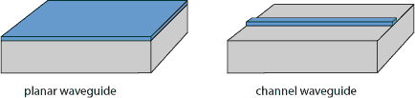
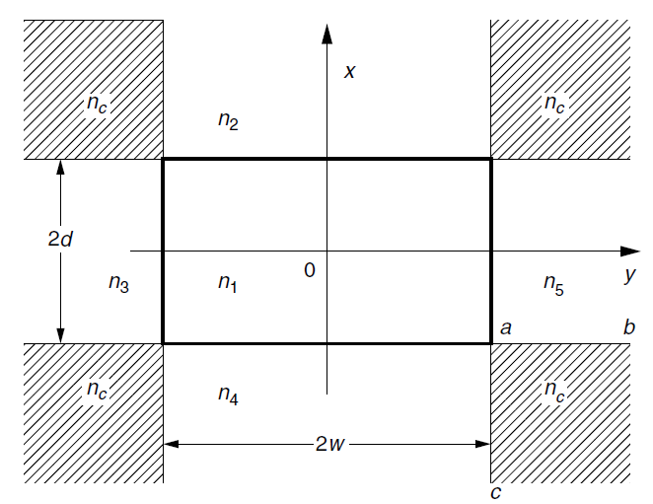
Channel Waveguides
Refractive index difference between core and cladding
→ Wave guiding

Slide 3
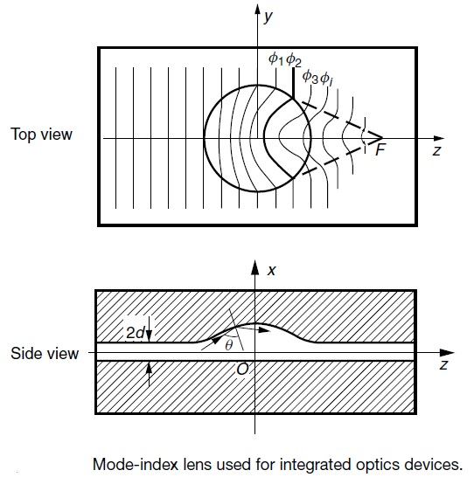
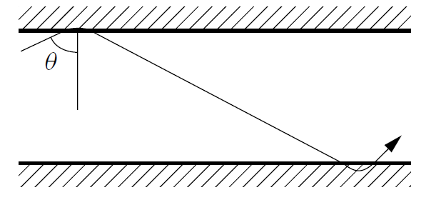
Effective Index

Slide 4
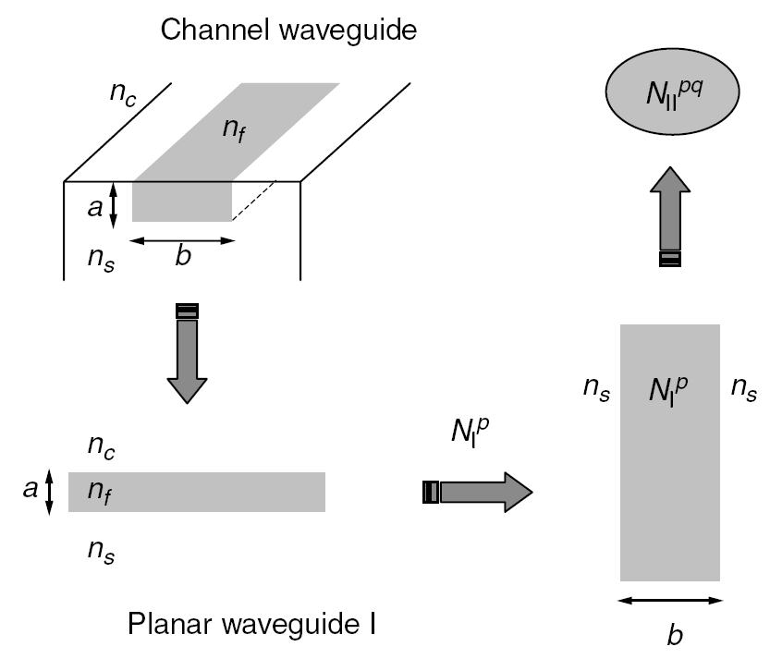
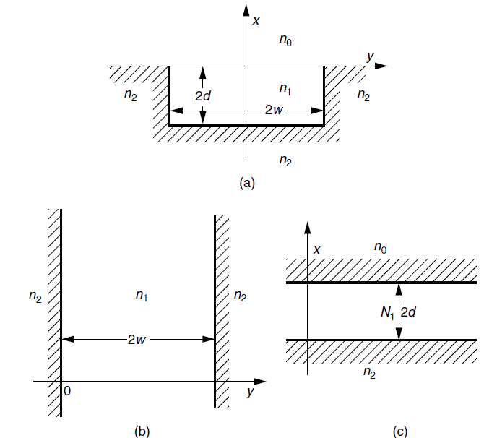
Effective Index method

Slide 5
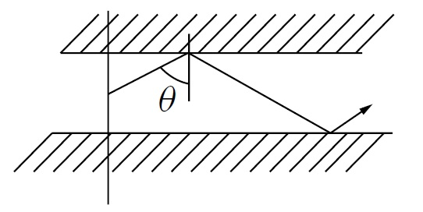
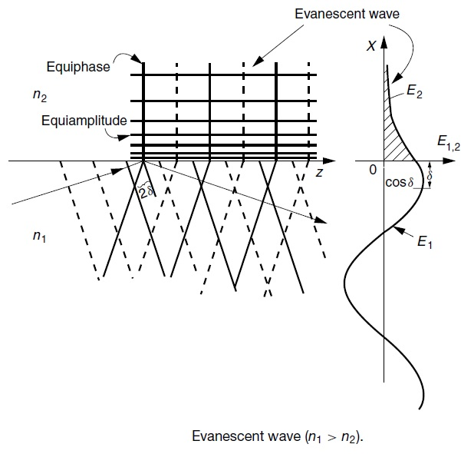
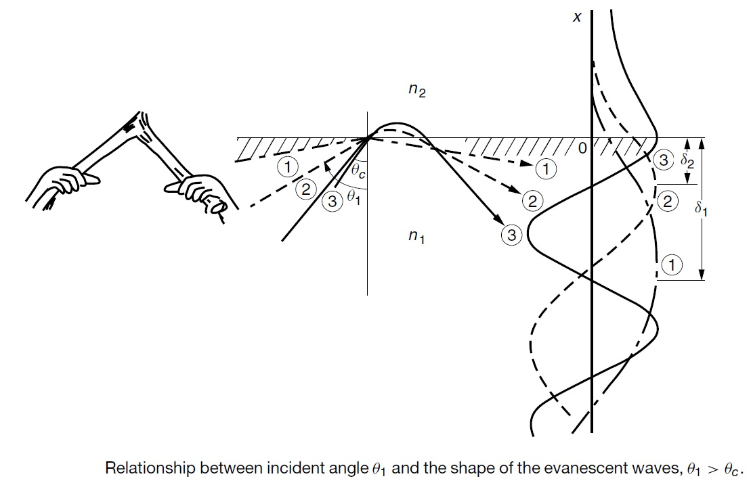
Evanescent Wave
Decrease in n₁-n₂→
Increase in effective depth of the evanescent wave (ϒ)
Increase in θ and N

Slide 6
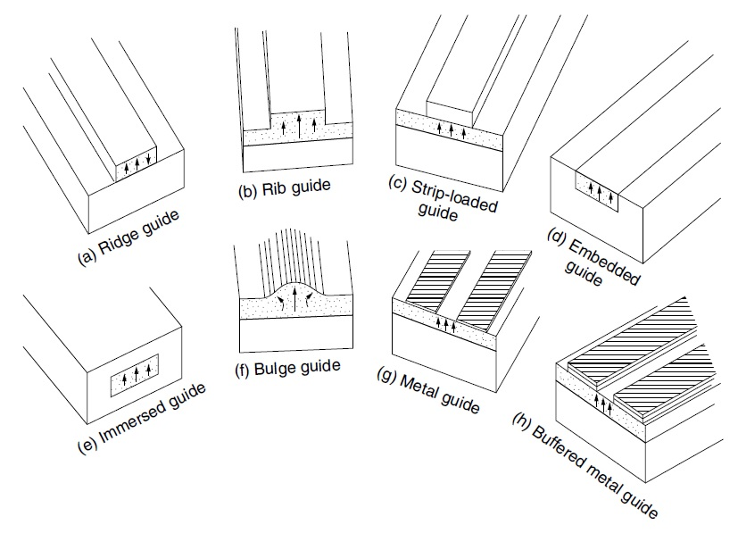
Various kinds of optical channel waveguides
.

Slide 7
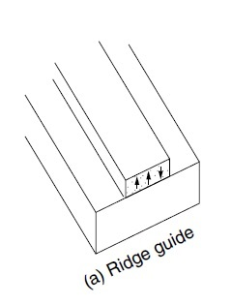
1- Ridge Waveguides:
Simple fabrication
(It looks structurally simple !)
The core strip is deposited directly onto the substrate of a lower index of refraction
Low Bending Loss (High contrast )
roughness on the air–film interface creates radiation loss
Three side walls of the core strip must be extra smooth to minimize the radiation loss
The evanescent wave is significantly reduced in air–film interface.

Slide 8
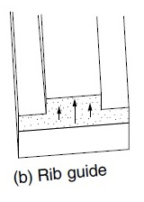
2- Rib Waveguides & Bulge Guide:
Increase in the thickness of the guide →Increase in the effective index in the center region → light is confined to this region
roughness on the air–film interface creates radiation loss
Three side walls of the core strip must be extra smooth to minimize the radiation loss
The evanescent wave is significantly reduced in air–film interface.

Slide 9
3- Strip Waveguides:
index of film > index of strip > index of air
Decrease in n1-n2→ Increase in θ and N→ Light Confinement
Low roughness Loss(scattering loss)
High Bending Loss
The evanescent wave is significantly reduced in air–film interface.

Slide 10
4- Embedded Waveguides:
High Bending Loss (low contrast )
Low roughness Loss(scattering loss)
Graded index
Suitable for Directional coupler
Electrodes can be deposited Directly in Electro-optic material

Slide 11
5- Immersed Waveguides:
High Bending Loss (low contrast )
Low roughness Loss(scattering loss)
Mathematical analysis is simpler because of the symmetries
There is no cutoff of the dominant mode
Is not suitable for devices that need electrodes

Slide 12
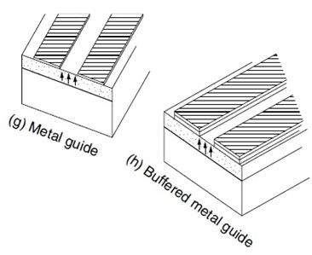
6- Metal Waveguides:
The center region is bordered by regions of lower Effective index
High Absorption Loss
The metal layers can conveniently be used as electrodes
The loss can be minimized by placing a dielectric buffer layer

Slide 13
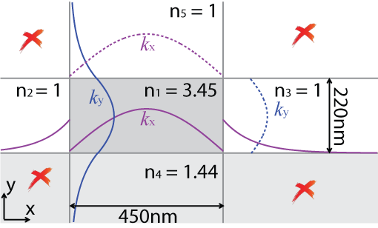
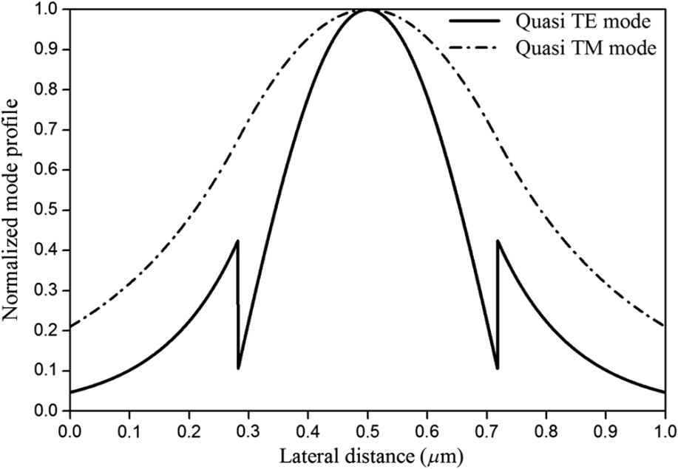
Slot Waveguides
Discontinuity of electric field

Slide 14
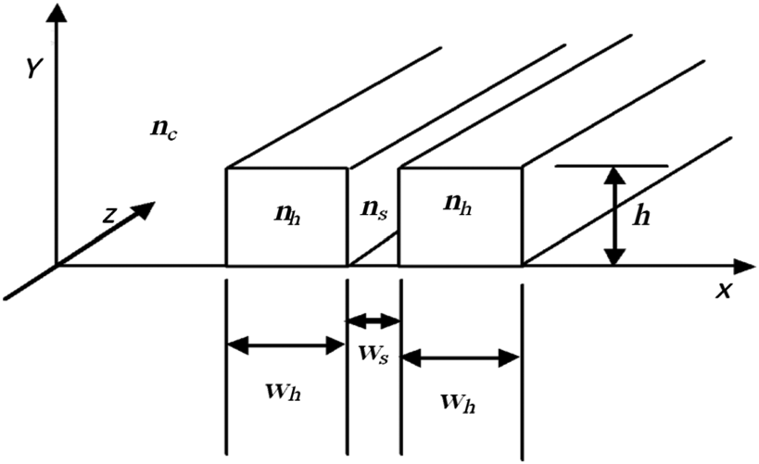
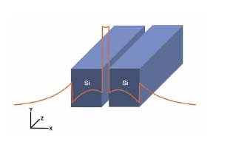
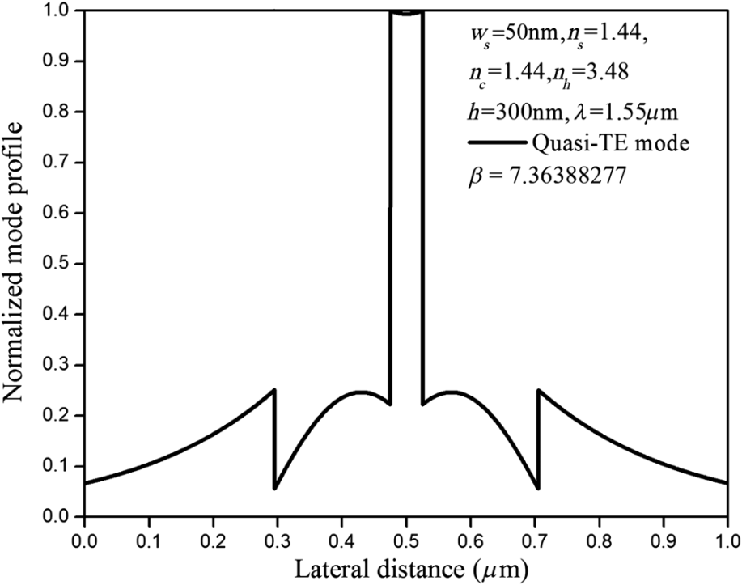
Slot Waveguides

